Slide 1

Analyzing Amazon Sales Data
A VISUAL EXPLORATORY ANALYSIS
A Presentation By -
Aditya Singh

Slide 2
INTRODUCTION
Welcome! Today, we’ll explore Amazon's extensive sales data, providing a snapshot of its global operations.
Global Reach: Sales data across regions and countries showcase Amazon's expansive market presence.
Product Variety: Diverse item types highlight consumer preferences and product performance.
Sales Channels: Insights into both online and offline sales pathways.
Operational Metrics: Tracking order and shipment details to understand logistics efficiency.
Financial Performance: Comprehensive data on revenue, costs, and profits.
This dataset is a window into Amazon’s strategic operations and market dynamics. Let's dive in and uncover the insights.

Slide 3
IMPORTANT KPIS
Total Profit
Total Revenue
Units Sold
Unit Cost
Unit Price
Sales Channel
Region
Country
Item Type

Slide 4
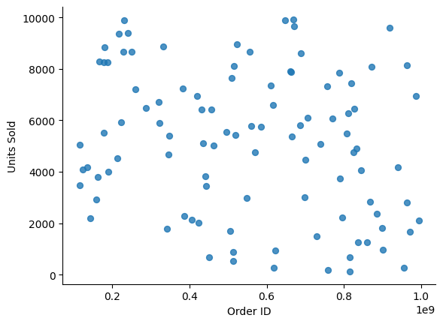
ORDER ID VS UNITS SOLD
The scatter plot shows the relationship between Order ID and Units Sold. The data points are scattered widely, indicating no clear correlation between the order ID sequence and the number of units sold. This suggests that sales volume varies independently of the order IDs.

Slide 5
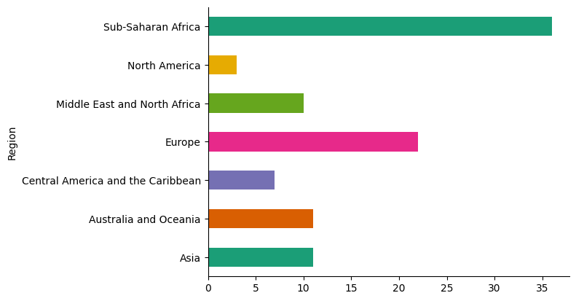
COUNT OF ORDERS BY REGION
The bar chart illustrates the total cost distribution across different regions. Sub-Saharan Africa incurs the highest cost, followed by Europe and the Middle East and North Africa. Other regions like North America, Central America and the Caribbean, Australia and Oceania, and Asia show significantly lower total costs in comparison.

Slide 6
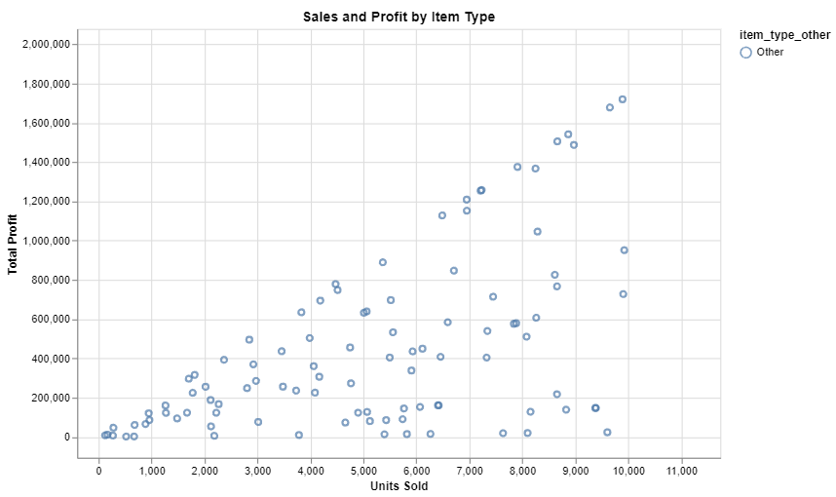
SALES AND PROFIT BY ITEM TYPE
The scatter plot shows the relationship between Units Sold and Total Profit for different item types. A positive correlation is evident, as higher units sold generally lead to higher total profit. Each point represents a specific item type's performance, indicating that increased sales volume tends to result in increased profitability.

Slide 7
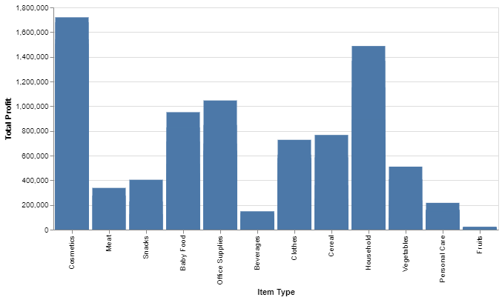
ITEM TYPE BY TOTAL PROFIT
The bar chart displays the Total Profit for various item types. Cosmetics and Household items generate the highest profits, while Fruits and Snacks contribute the least. Office Supplies and Baby Food also show significant profits, whereas Personal Care and Meat have relatively lower profitability.

Slide 8
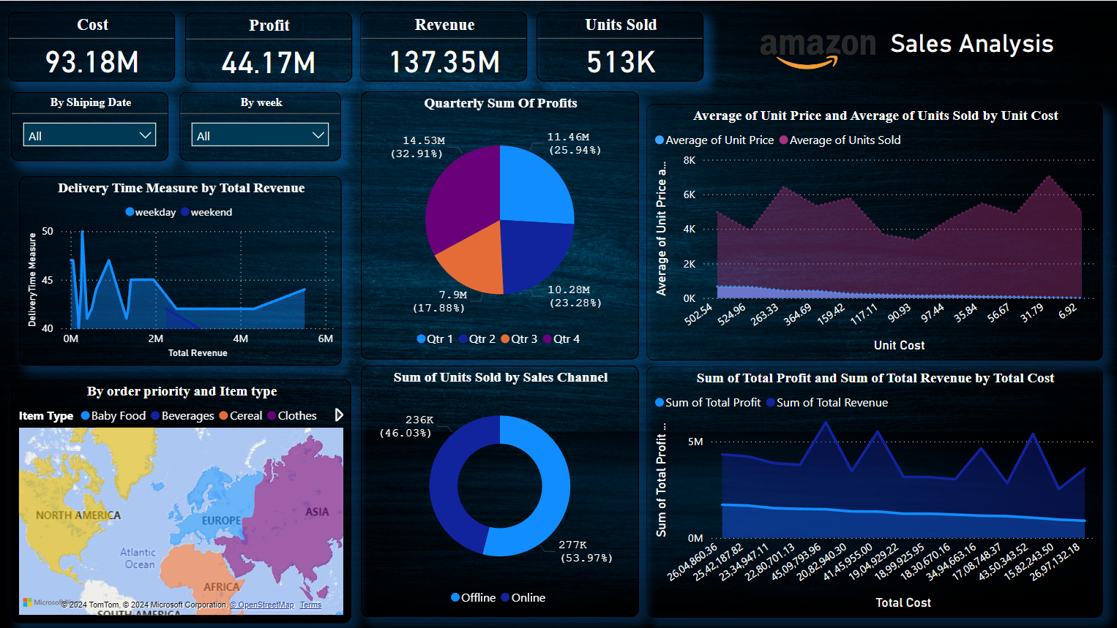
POWER BI DASHBOARD (1)

Slide 9
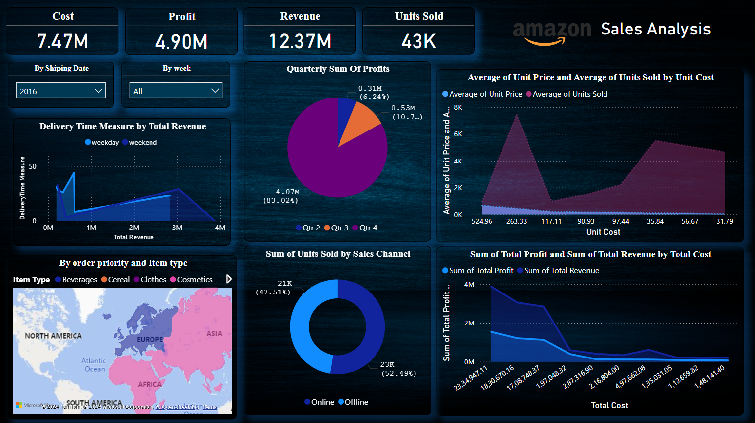
POWER BI DASHBOARD (2)

Slide 10
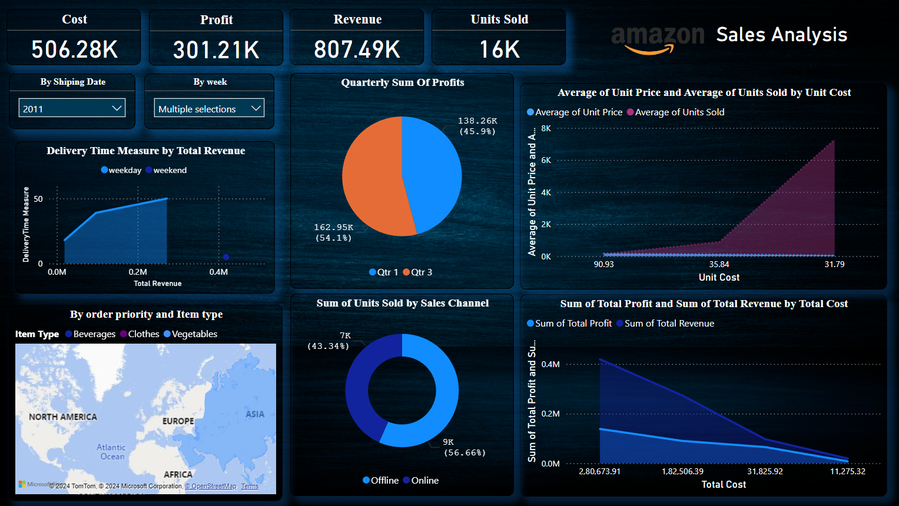
POWER BI DASHBOARD (3)

Slide 11
Thank you!
HAVE A NICE DAY!
Aditya Singh
csaditya44@gmail.com
(+91) 7379356275

